Slide 1
Energy Storage Engagement and Progress Update
September 1, 2022
Public

Slide 2

AESO Stakeholder Engagement Framework

Slide 3
Energy Storage Roadmap Update
Public

Slide 4
Introduction and purpose
Provide a quarterly progress update on energy storage activities:
  Share progress update on the Energy Storage Roadmap integration activities since the January 2021 update;
  Provide an update on activities planned for Q2 and Q3 2022;
  Provide an update on interrelated initiatives; and
  Provide an opportunity for stakeholders to submit questions on the update information provided.
“The information contained in this document is for information purposes only. As such, the AESO makes no warranties or representations as to the accuracy, completeness or fitness for any particular purpose with respect to the information contained herein, whether expressed or implied. While the AESO has made every attempt to ensure the information contained herein is timely and accurate, the AESO is not responsible for any errors or omissions. Consequently, any reliance placed on the information contained herein is at the reader’s sole risk.”
Public

Slide 5
What’s New Since May?
Public

Slide 6
Active connection projects update
There are four ES-connected projects to the AIES
There are 37 projects currently on the connection list; below those with ISD in 2022:
  ATCO Mercer Hill DER Battery
  ATCO Sturgeon DER Battery
  EDTI DG Solar
  Fortis Alberta Killarney Lake DER Solar + Storage
  Fortis Nilrem DER Battery
  Fortis Hughenden DER Battery
Public

Slide 7
Fast Frequency Response Pilot Update
Activities completed since the last update:
  AESO is gathering technical, and market learnings from the pilot since March 2022
Next steps:
  Evaluate the data, constraints, performance, and barriers to inform the future design of FFR services
Further information on the FFR Pilot is available on the AESO’s website: https://www.aeso.ca/market/ancillary-services/fast-frequency-response/
Questions can be directed to EnergyStorage@aeso.ca
Public
Notes:
Refresher slide, same as Oct. 14th general update
NOTE: confirm if we want to tie FFR to imports still, in light of the weakly interconnected/islanded LSS product development ? (Ata and team)

Slide 8
Energy Storage Industry Learnings Forum (ESILF)
The 5th ESILF workshop was held on June 10th, 2022
Topics presented and discussed were:
  Energy Storage Standardized Solutions
  Storage on the California Grid
This session’s presentation and summary, as well as previous sessions’ materials are posted on the AESO’s website:
https://www.aeso.ca/grid/grid-related-initiatives/energy-storage/energy-storage-industry-learnings-forum/
Next ESILF session is planned for November 2022
Public

Slide 9
Looking Ahead
Public

Slide 10
Cross-Functional Internal Work Continuing Through 2022
Initiation phase to frame the scope for processes, systems and tool changes underway; plan to complete in Q4 2022
ISO rule amendments invitation for stakeholders' engagement sessions in September posted on August 18th; further information on this process can be found on the AESO website:
  https://www.aeso.ca/stakeholder-engagement/rules-standards-and-tariff/energy-storage-rule-amendments/
Public

Slide 11
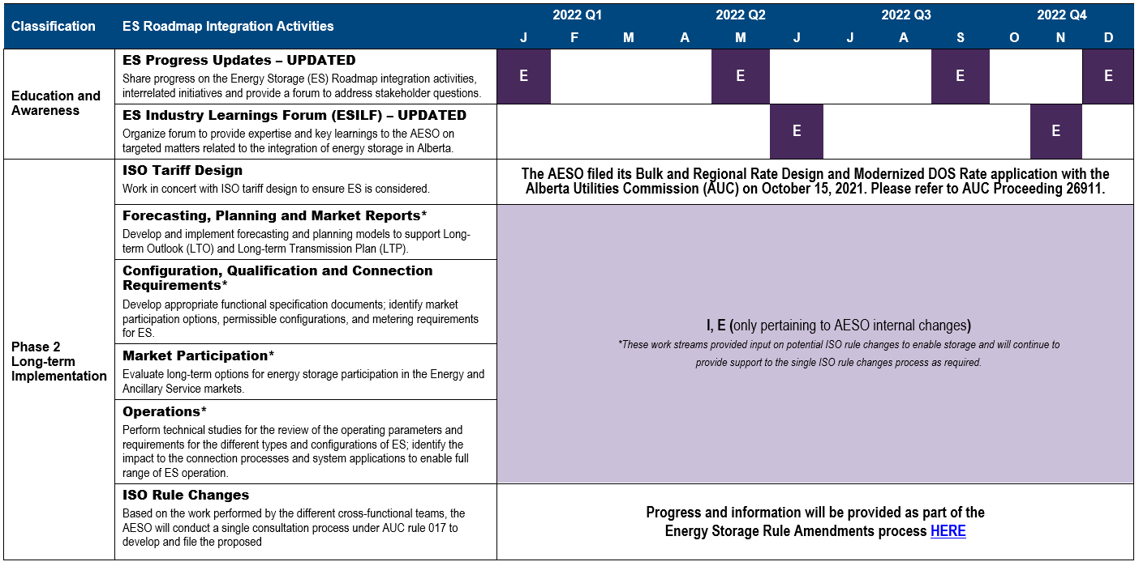
12-Month Rolling Timeline
E – Engagement: inform and/or discuss topics with Stakeholders
A – Analysis: internal work phase for the AESO where an activity is researched, performed analytics, studies, etc.
C – Conception: after analysis, AESO will conduct an options analysis and may develop recommendations on the matter.
D – Development: AESO shares recommendations and works with stakeholders to create proposed ISO rules or changes to existing ISO rules.
I – Implementation: includes changes to IT, business processes and training to integrate ES.
Public

Slide 12
In Summary…
Continue with ISO rules development
Continue with the internal work for ES long-term implementation
ESILF Workshop 6 to be held in November
Next progress update session will be provided in December 2022 or early January 2023
Public

Slide 13
Interrelated Initiatives Update
Public

Slide 14
ISO Tariff Design
The AESO’s Bulk and Regional Rate Design and Modernized DOS Application can be found here:
  https://www.aeso.ca/rules-standards-and-tariff/tariff/current-applications/
An oral hearing was held in June 2022
The proceeding is closed as of August 16, 2022; currently awaiting the Commission’s decision on the Application
For more information regarding this Application, please refer to Alberta Utilities Commission Proceeding 26911
Public

Slide 15
Questions?
If you have questions related to this update, please email EnergyStorage@aeso.ca with the subject ES Q3 Update by September 16, 2022
Public

Slide 16

Contact the AESO
  Twitter: @theAESO
  Email: energystorage@aeso.ca
  Website: www.aeso.ca
  Subscribe to our stakeholder newsletter
Public

Slide 17
Thank You
Public

